Slide 1



FIRE FIGHTING DRONE
PROJECT
Aryan
Tanmay
Parth
Jainil
Vansh
Mayank
Presented By: Team AGNI Drone

Slide 2


OUR PROJECT TIMELINE
PLANNING
PRE-DESIGN
DEVELOPMENT
TESTING
Strategic Goals
Implementation
First to built a simple quadcopter using the Cross Flight flight controller to gain basic flight experience. Conducted component research to identify motors, ESCs, props and a lightweight frame capable of carrying a water-pipe assembly in final Hexacopter drone model.
To make this assembly we have used PVC pipes with T and Plus joints and for Moter we used custom 3D Printed motor Mounts.
Blueprint Creation
Quality Assurance
Created CAD layouts for a hexacopter frame to check stress distribution. Finalized specs for tubing diameter, pump flow rate and battery capacity to balance weight, thrust and firefighting payload requirements.
Total Flight Time: Nearly 2 hours in around 24 test flights.
Height achieved: Successfully lifted the water up to 10m of height

Slide 3

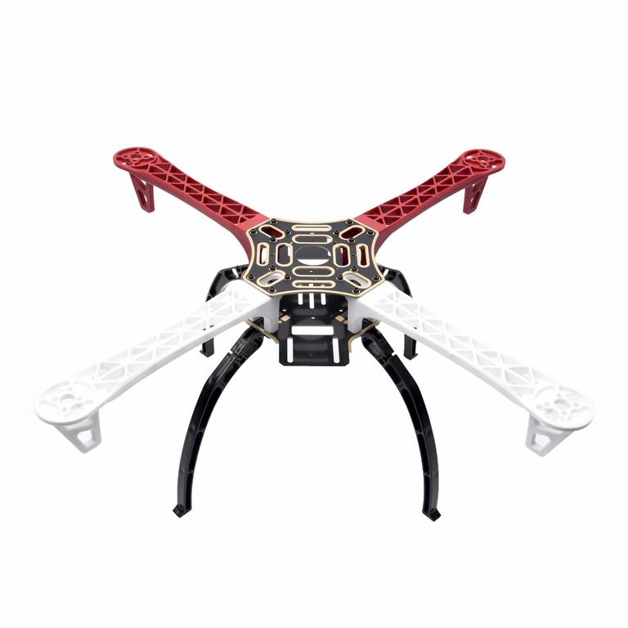
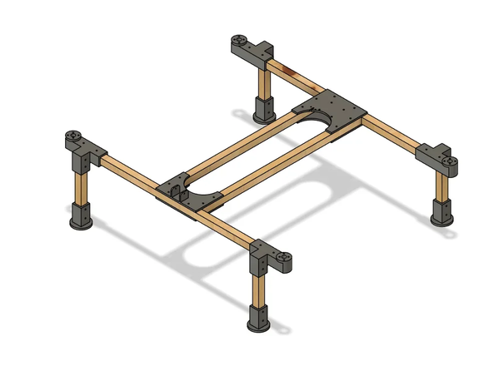
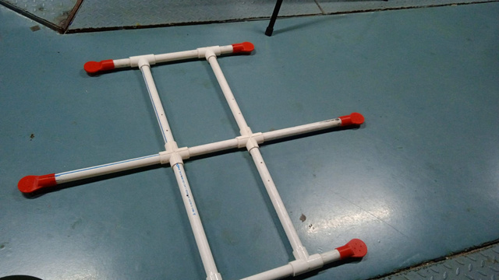
DRONE COMPONENTS
01
FRAME
Initial Learning Phase
We initially planned to build this heavy lift drone in multiple stages
Started by studying a already available quadcopter F450 frame .
Exploration and Inspiration
Found an H-type quadcopter design online.
Took inspiration from the H-type structure for better stability.
Design Modification
Modified the H-type quadcopter frame into a hexacopter frame.
Increased motor count for improved load handling.
One feature we believe sets our design apart from others is that it can be assembled without using a single screw.
Configuration Choice
Adopted a Plus (+) type configuration for the hexacopter because it has better control on movement of drone at slower speeds.
Performance Considerations
Plus type has slightly higher aerodynamic drag.
Drag increase is acceptable due to our low-speed application.
Gains in stability and easier control outweigh the minor drag penalty.
F450 Frame
03
Our Design Inspiration
Final Design of Our Prototype

Slide 4
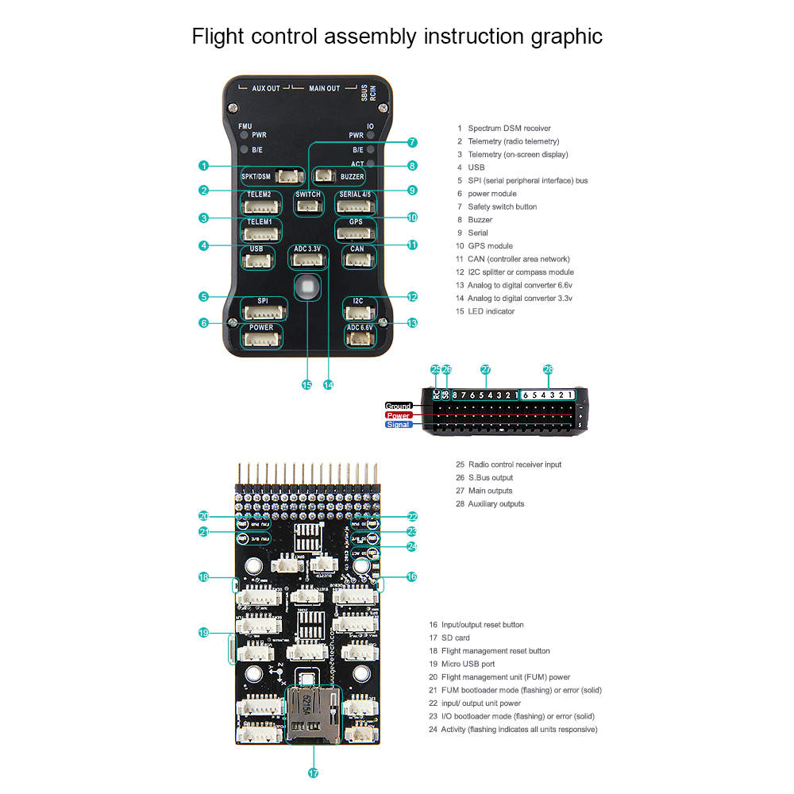
DRONE COMPONENTS
02
FLIGHT CONTROLLER
Built-In Sensors: 6-axis IMU (3 Axis Accelerometer + 3 Axis Gyroscope), Barometer and Magnetometer keep your hexacopter level and aware of altitude and heading.
Auto-tune, in-flight parameter adjustment(PID Tuning), mission scripting.
Hexacopter-Ready I/O: Up to 8 motor outputs plus ports for GPS, Telemetry radios, RC receiver and additional sensors—all on one board.
Smart Failsafes: Auto Return-to-Launch, auto-land on low battery or signal loss, and real-time power monitoring to protect your drone.
Seamless integration with Mission Planner(PC), QGroundControl(Mobile), MAVProxy software, for Sensor Calibration and Tuning.
It also enables us to do Autonomous flights with some sensor integration and software settings.
03
03
Image Source: https://encr.pw/fQeDP

Slide 5
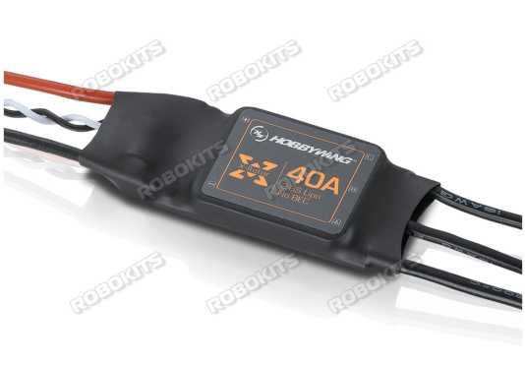
DRONE COMPONENTS
03
ELECTRONIC SPEED CONTROLLERS (ESCS)
Working of ESC
Control the speed and direction of the motor by supplying power to them.
Specification of chosen Hobbywing XRotor 40A 2-6s ESC :
Provides a continuous current of 40 A with a peak current of 60 A.
It has a throttle signal frequency up to 621Hz.
This ESC supports 2s to 6s batteries.
smooth throttle response, protection circuits and is very efficient.
it’s PWM(Pulse Width Modulation) signal give finer resolution control for flight controllers
03
https://robokits.co.in/multirotor-spare-parts/brushless-motor-propeller-esc/esc/hobbywing-xrotor-40a-2-6s-esc

Slide 6
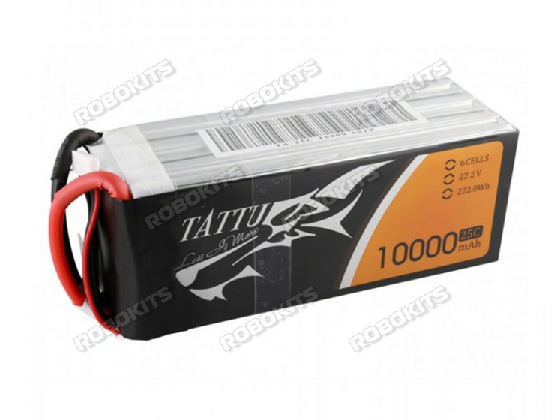
DRONE COMPONENTS
04
BATTERY
Working of Battery:
Provide the power necessary for extended flight durations.
Specification of chosen Tattu 10000mAh 6S 25C 22.2V LiPo battery :
Provides a capacity of 10000mAh (10Ah) with 22.2 V voltage drop.
It has a discharge rate of 25C and a max burst discharge Rate: 50C
It weights around 1420g.
it has a maximum continuos current of 250 Amps
Flight time is around 15 to 20 minutes.
This Battery is a 6s battery that supports an ESC.
The motor in this drone is optimized for 6 S (≈ 22.2 V) operation, providing 320 RPM/Volt to generate 1.3–1.5 kg thrust per motor.
03
https://robokits.co.in/batteries-chargers/drone-batteries/tattu-lipo-batteries/tattu-6s-battery/tattu-10000mah-6s-25c-22.2v-lipo-battery

Slide 7
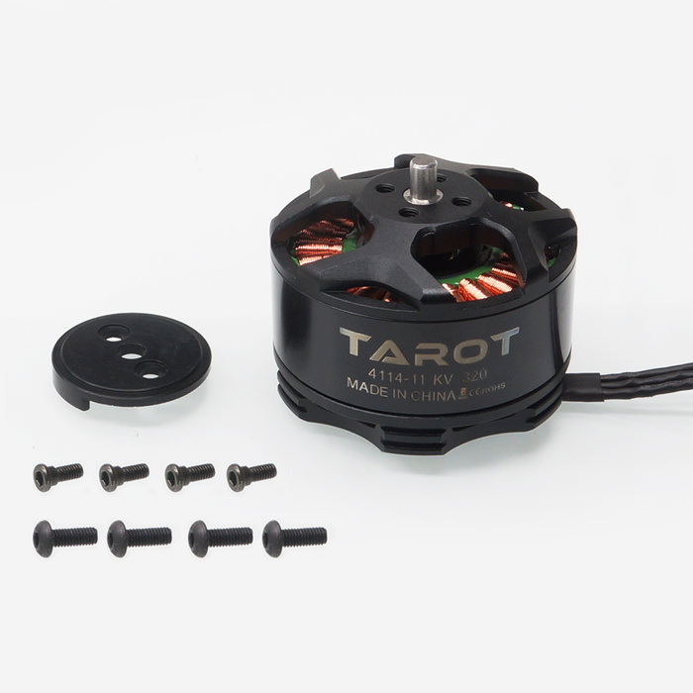
DRONE COMPONENTS
05
MOTORS
Tarot 4114/320KV Brushless Motor
Purpose: Provides strong lift and stable performance for hexacopters carrying heavy payloads (pipe and water).
Thrust
Each motor's weight is 148 grams. We choose lightweight motors for heavy lift applications.
Each motor with a (15-inch propeller) can produce around 1.8 kg at 80% thrust. Motor speed is 5511 RPM. The total thrust is 10.8 kg. The total drone weight is near with pipe nearly 4.5 kg without water. So it can easily carry water through the pipe.
According to this thrust requirement, we selected 15-inch diameter propellers by considering Tarot 1441/320 KV Brushless motor.
Material Properties
This tarot motor is made of an alloy steel shaft, and the special bearings are used for low friction.
03
Tarot 4114/320KV Brushless Motor
Stator Size: 41X14 mm

Slide 8
DRONE COMPONENTS
05
MOTORS
Tarot 4114/320KV Brushless Motor
Properties
Stator gives better heat dissipation means the motor can release this heat faster into the air — cooling itself down more effectively.
Better heat dissipation helps the motor stay cool, improving performance, efficiency, and durability during heavy flights
320KV motors (KV tells you how fast the motor spins when you apply 1 Volt with no load.) are lower KV motors it gives more torque, less speed and it is selected according to large propellers, and stability.
03
Tarot 4114/320KV Brushless Motor

Slide 9
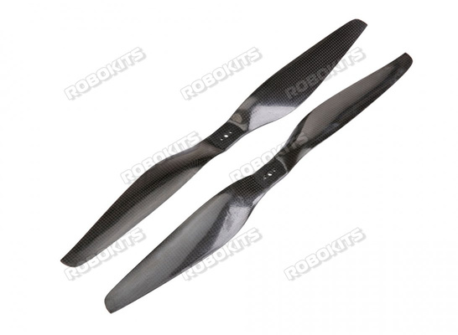
DRONE COMPONENTS
06
PROPELLERS
Propeller
The drone required significant thrust and efficiency, so considering this, we selected a 15-inch diameter(5.5 inch pitch) size propeller also according to our prototype. So the propellers can't collide with each other.
Both types of propellers used CW and CCW.
Propeller's material is carbon fibre, which is strong, lightweight and highly durable. Carbon fibre reduces flexing at high RPM and maintains propeller shape.
The propeller's large size and light weight (40g/propeller) give better lift, lower power consumption and improve flight time.
03
Carbon Fibre Propellers

Slide 10
Maximum Height upto which the Drone can Go while carrying water
Thrust Provided at 80 % Throttle = 1.8 kg per motor
Total Thrust = 1.8 X 6 = 10.8 kg
Mass of Drone Itself = 4.5 kg
This Extra thrust would be responsible to carry weight of pipe and water (which is depend of Height of Drone )
We did the Calculation using Density and Volume of common garden Pipe material and water inside it.
We found out that Theoretically the Drone can go upto 22 m or 70 Feet of Height while carrying water.

Slide 11
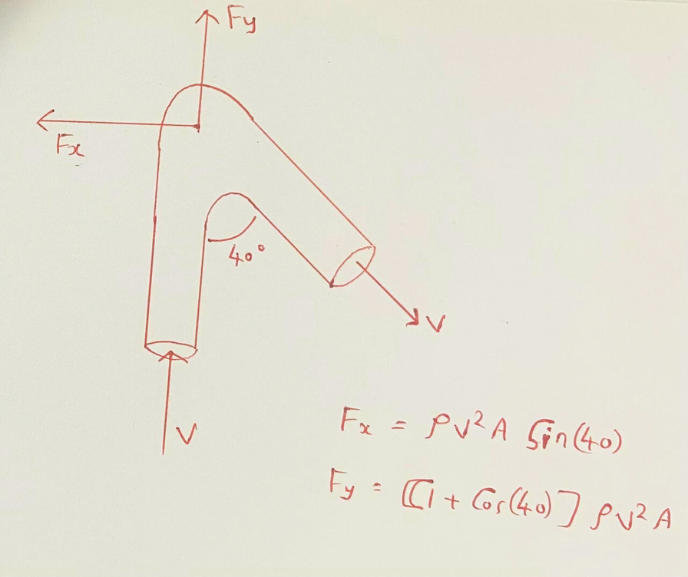
Maximum Velocity and Volume Flow Rate that can be kept while Spraying Water.
As We Spray water by attaching a pipe , a Thrust Force due to Water is Experienced by the Drone.
This Thrust force should not be greater than the maximum Forward force the Drone provides.
Thus using this information , we found the
Maximum Velocity of Water = 7.5 m/s
Maximum Volume FLow rate = 2.5 L/s or 150 L/min

Slide 12
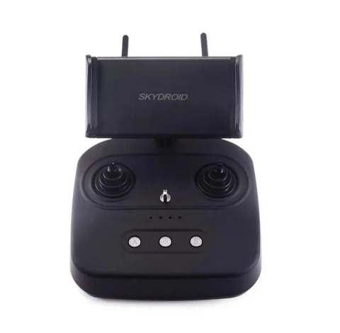
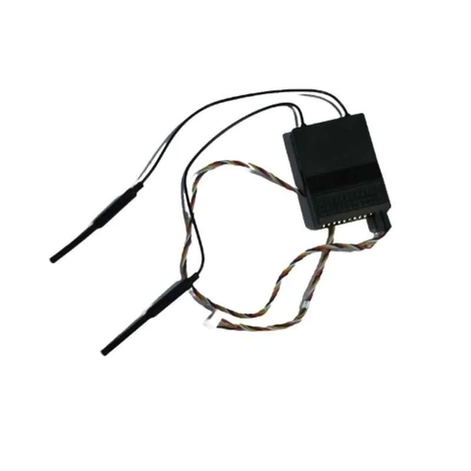
07
RECEIVER AND TRANSMITTER
TRANSMITTER
RECEIVER
Device: Skydroid T10 Remote Controller (Handheld device)
Function: Sends control signals (joystick inputs, switches, and buttons) to the drone or vehicle.
Features:
Device: Skydroid R10 Mini Receiver (Drone-mounted device)
Function: Receives control signals from the transmitter and sends telemetry data back to the ground station.
Features:
10 channels (physical control channels) to which we can assign different functions
Antenna: 2.4 GHz 3 dB built-in antenna
App Integration: Bluetooth connectivity for parameter adjustments, channel binding, failsafe settings, and firmware upgrades via the Device Helper mobile App
Send commands 300 times per second
Dual 2.4 GHz antennas for strong, stable signal reception
Binding button and LED indicators for easy connection and status monitoring
Supports Bluetooth firmware updates via Device Helper app
Digital Video Link: Up to 7 km line-of-sight
Data & Telemetry Link: Up to 10 km line-of-sight

Slide 13
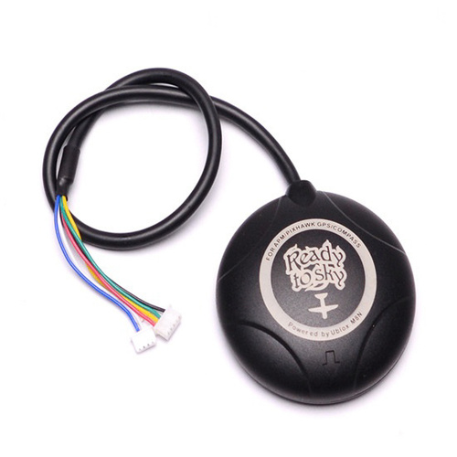
08
NEO-M8N READYTOSKY GPS
🔹 Basic Working Principle
GPS Functionality:
Receives satellite signals from multiple constellations (GPS, GLONASS, Galileo, BeiDou).
Calculates precise 3D position (latitude, longitude, altitude) by triangulating distance from satellites.
Uses WGS-84 coordinate system for mapping locations.
Compass (Magnetometer) Functionality:
Measures Earth’s magnetic field to determine heading (orientation of the drone).
Assists in stable direction control and Return-to-Home (RTH) navigation.
Flight Controller Interface:
Sends GPS position and compass heading data to Pixhawk via serial communication.
Enables real-time navigation, waypoint tracking, and autonomous flight.

Slide 14
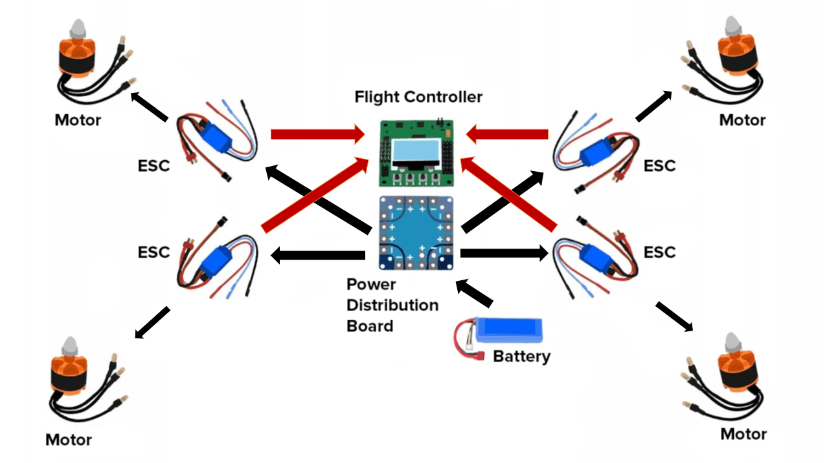
DRONE COMPONENTS
09
POWER DISTRIBUTION CHART

Slide 15

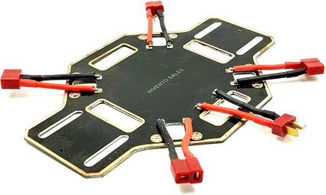
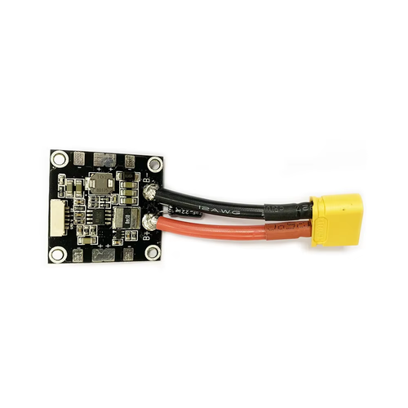
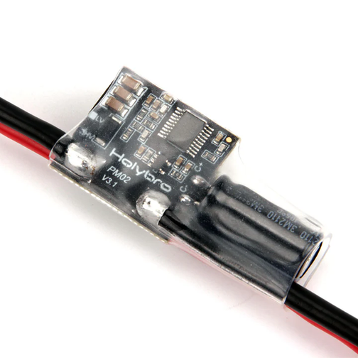
DRONE COMPONENTS
10
POWER DISTRIBUTION
Battery to ESC’s through PDB :
The main battery’s (LiPo battery) two wires are directly soldered or connected via connectors to the input VSS and GND of the Power Distribution Board (PDB) for powering esc through the VSS output sets (for our quad drone) of output pads for each ESC getting same voltage (Parallel connection).
Power to Flight Controller and Receiver:
We have used a 1 x Power Module: PM02 V3 12S .
PM02 V3 acts as a power module for Pixhawk with safe 5.2V supply. it also Monitors Battery Voltage and Battery Current (This data is sent to the Pixhawk for battery percent, consumption, warnings)
In our Quad drone we have used cross flight Power module to power ESC and FLight controller.

Slide 16
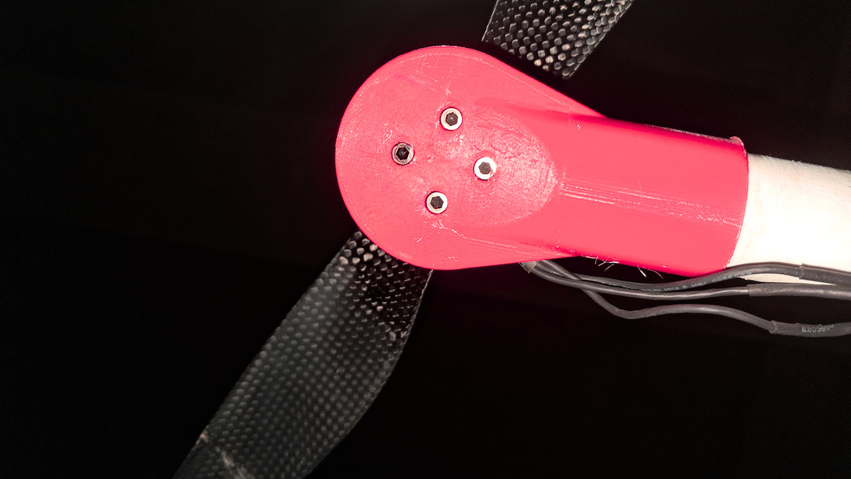
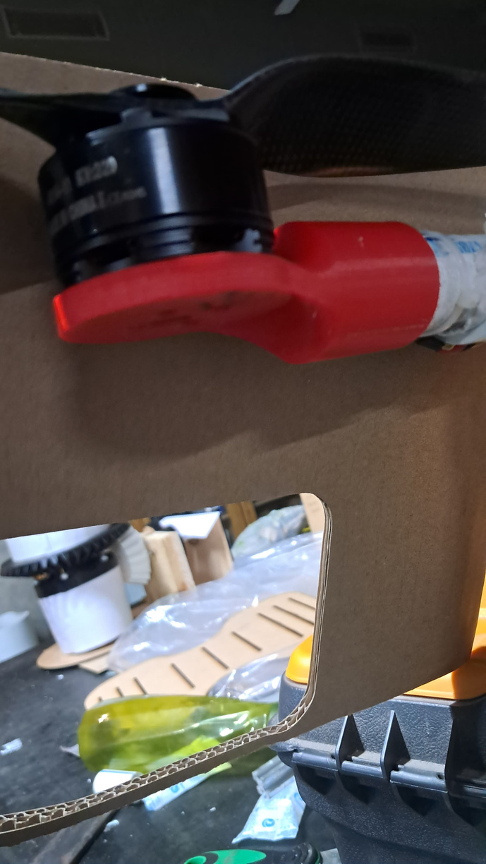
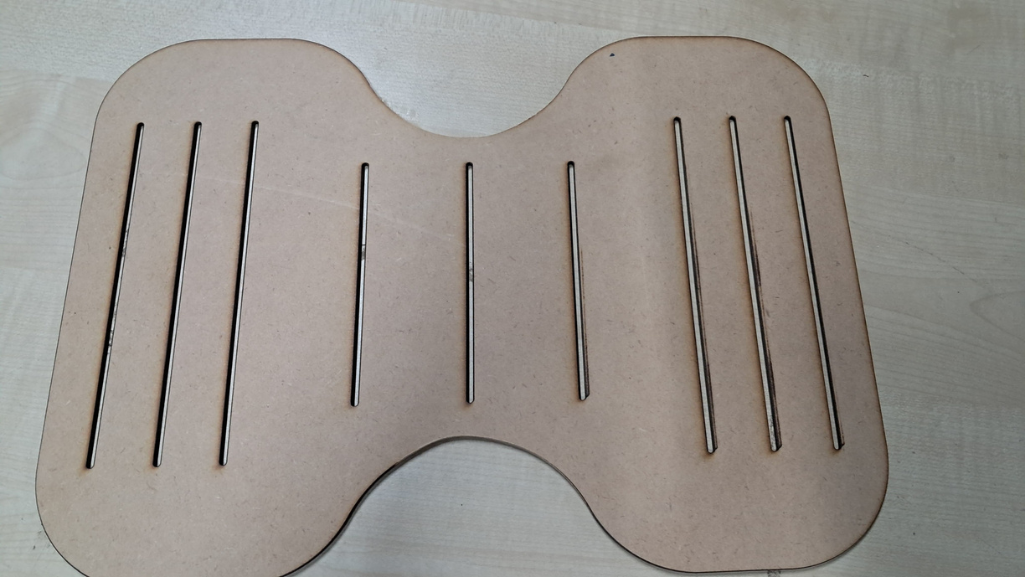
DRONE COMPONENTS
11
3-D PRINTED AND LASER CUT PARTS
Designed using Autodesk Inventor and Fusion 360
Total 6 motor holders Securely mount the motors onto the drone frame.
Filament Type: Tough Red PLA
Print Core: AA 0.4
Infill Density: 20% ( for reducing the weight of the component)
Infill Pattern: Triangles ( very high strength to density ratio)
Mass per Motor Holder: 34 grams
The 3-D printed support plate was used to hold the electronic components (like flight controller, receiver and Battery)
Features of the Parallel Vents in the Plate:
Air Ventilation: Allows smooth airflow through the plate to prevent unwanted thrust or turbulence and improve stablity.
Component Centering and Support: Helps securely hold and align components at the center of the drone.

Slide 17
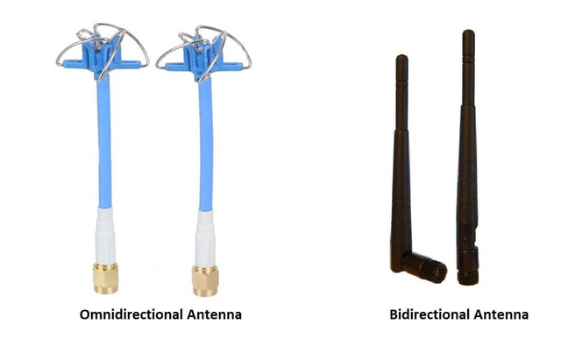
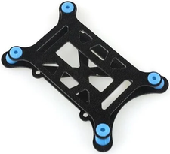
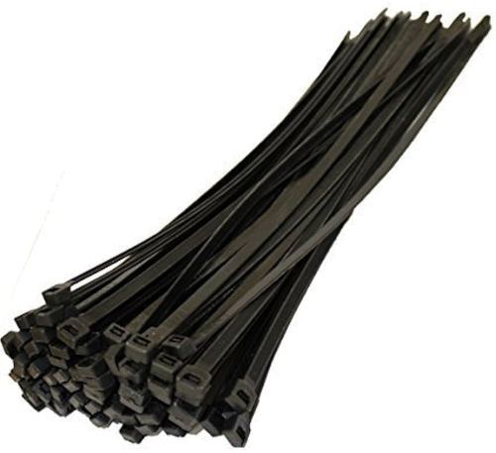
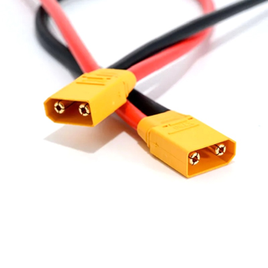
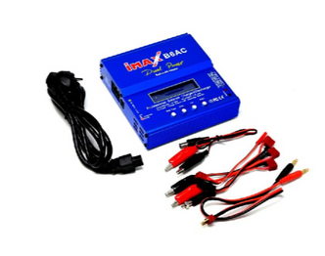
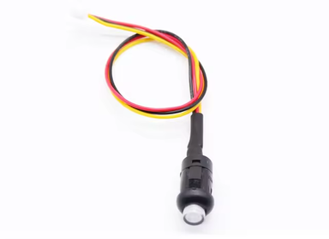
DRONE
SUB-COMPONENTS
01
VIBRATION DAMPERS
04
ANTENNA
02
WIRES AND CONNECTORS
05
MOUNTING HARDWARE
03
03
SAFETY BUTTON
06
BATTRY CHARGER
01

Slide 18
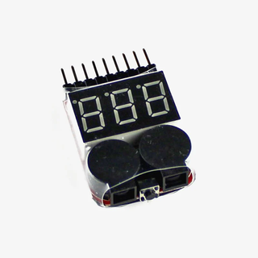
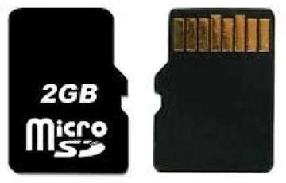
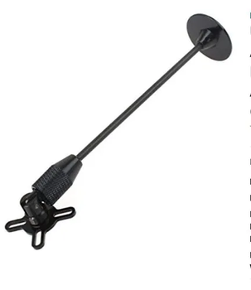
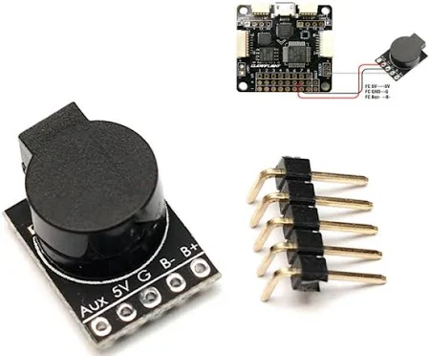
DRONE
SUB-COMPONENTS
07
LIPO-CHECKER
09
SD-CARD
03
08
GPS MOUNT
10
BUZZER
01

Slide 19
TESTING VIDEO
https://iitgnacin-my.sharepoint.com/:v:/g/personal/23110300_iitgn_ac_in/EXxrx1mxkjNOrGBSVK1xQfgBHd3mzywUZGAm6lMl7FmELg?e=0giEab

Slide 20
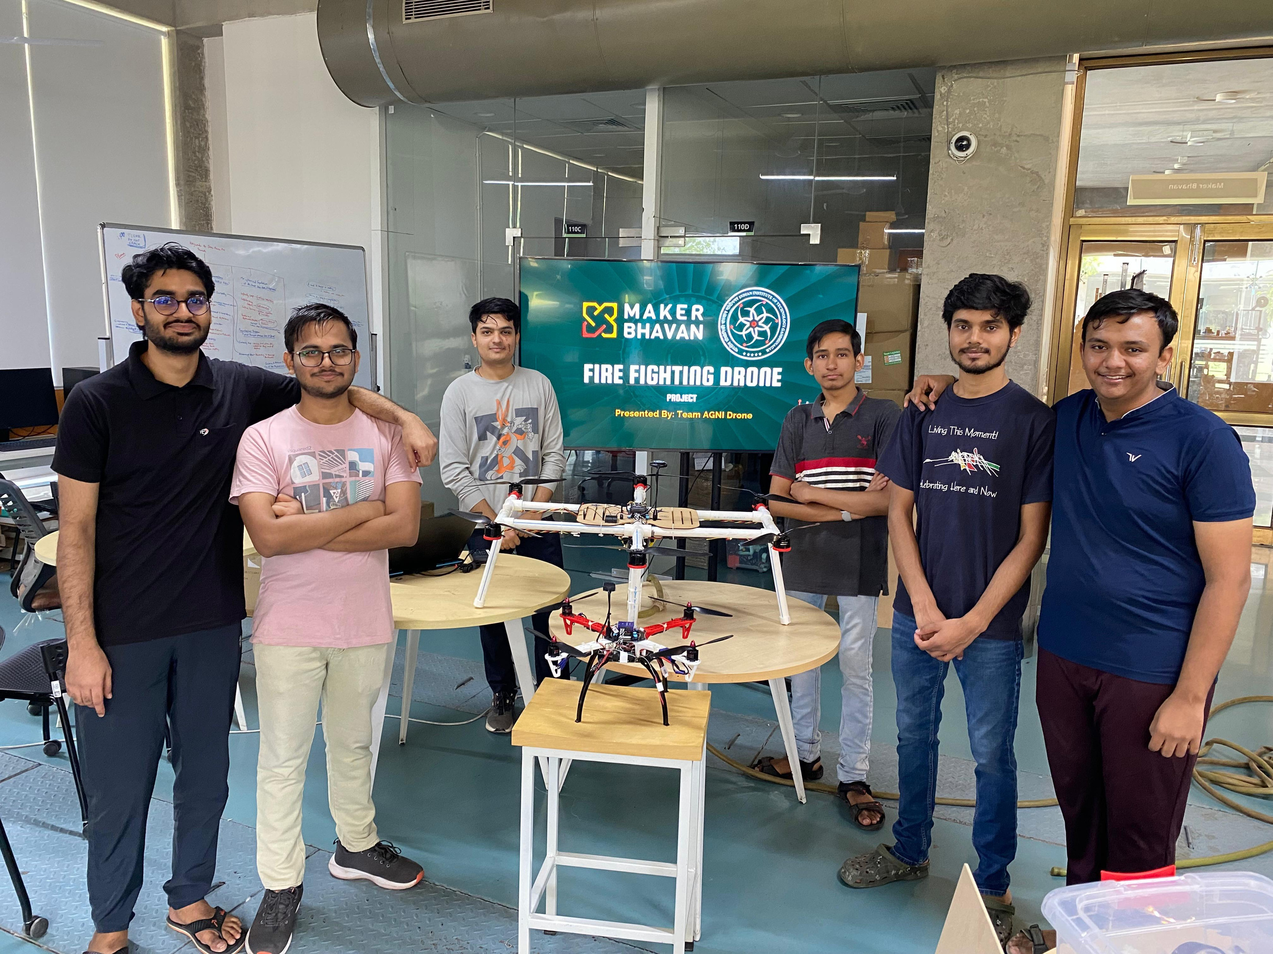

Slide 21


THANK YOU
THANK YOU

